Slide 1
https://www.youtube.com/watch?v=QXT4OVM4vXI

Slide 2
Chemical Bonds
-
+
+
-

Slide 3
Learning Targets
I will be able to:
distinguish between the different types of bonds.
illustrate chemical bonding through Lewis Dot structures.
predict properties of substances based upon bond type.

Slide 4
Chemical Bonds
chemical bond: a force of attraction that holds two atoms together
Has a significant effect on chemical and physical properties of compounds
involves the valence electrons
Valence Electrons: the electrons in the s and p orbitals of the outermost energy level of an atom
This Lithium
Atom has one
valence electron

Slide 5
Counting Valence Electrons
Carbon
4 valence
electrons
Beryllium
2 valence
electrons
Oxygen
6 valence
electrons

Slide 6
Determining the Number of Valence Electrons by Using the Periodic Table
Atoms of elements in Groups 1 and 2 have the same number of valence electrons as their group number.
Atoms of elements in Group 3-12 do not have a general rule relating their valence electrons to their group number. However, they typically have between 1 or 2 valence electrons.
Atoms of elements in Groups 13-18 have 10 fewer valence electrons than their group number. (Exception - helium atoms have only 2 valence electrons, even though they are in group 18)

Slide 7
How Many Valence Electrons?
Hydrogen
Lead
Xenon
Sulfur
Rubidium
1 Valence
Electron
4 Valence
Electrons
8 Valence
Electrons
6 Valence
Electrons
1 Valence
Electron

Slide 8
The Octet Rule
Octet Rule: atoms tend to gain, lose or share electrons so as to have 8 electrons in the valence shell
  Atoms with less than 4 valence electrons tend to lose electrons.
  Atoms with more than 4 valence electrons tend to gain electrons.
Be aware that there are some exceptions!
CONSIDER EIGHT A HAPPY NUMBER FOR ATOMS!

Slide 9
The Octet Rule In Action
6
7
Notice how this chlorine atom has seven valence electrons, one away from eight. It will try to gain one more according to the Octet Rule.
5
4
-
1
1
-
-
-
-
3
2
+
+
+
+
+
Notice how the sodium atom has one valence electron. It is this electron that it will try to get rid of according to the Octet Rule.
+
+
+
-
+
-
+
+
-
-
-
-
Where do you think Chlorine finds that one electron that it needs?

Slide 10
Lewis Structure (Electron Dot Diagram)
Lewis Dot Structure: diagrams that show the bonding between atoms of a molecule and the lone pairs of electrons that may exist in the molecule
Lewis dot structures use the symbol for the element surrounded by as many dots as there are electrons in its outer energy level (valence shell)
Examples
How many valence electrons do each of these atoms have?

Slide 11
Making an Electron Dot Diagram
Element “X” has 8 valence electrons
Write down the element’s symbol
and place the first two dots on any
side of the symbol.
2
3
4
1
If this were an atom of an element
from group 1, you would just place the
one dot on any side of the element.
Place the rest of the dots in either a
clockwise or counter clockwise manner around
the symbol, with no side receiving two dots
until each side gets one.
5
6
7
8

Slide 12
What Would the Electron Dot Diagram Look Like?
1 Valence Electron
6 Valence Electrons
H
O
How many valence
electrons does
each atom have?
Ne
Sr
8 Valence Electrons
2 Valence Electrons

Slide 13
Oxidation Number
oxidation number: the charge that an atom would have if it lost or gained electrons; ionic charge
Can be helpful in determining which atoms will interact or bond with each other
Example:
According to electron dot diagram for Magnesium, it has two valence electrons. Because Magnesium is “unhappy” with two, it will typically lose them. If this happens it will turn into a Magnesium ion. At this point it will have an oxidation number of +2.
Mg
2+

Slide 14
What Could the Oxidation Number Be?
H
O
+1 or -1 because it can
gain or lose one electron
-2 because it will
gain two electrons
Ne
Sr
0 because it will not
gain or lose electrons
+2 because it will
lose two electrons

Slide 15
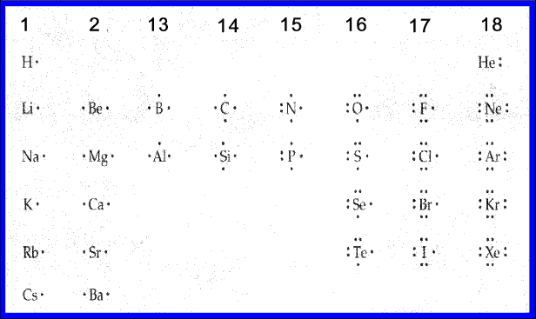
Lewis Dot Structures of Atoms

Slide 16
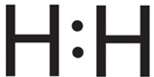
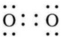
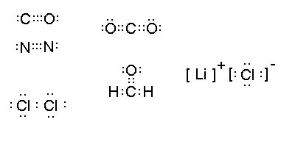
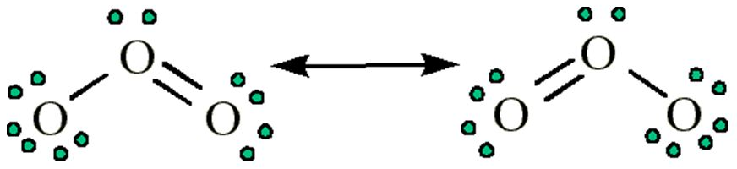
Lewis Dot Structures of Molecules
Single Bond: Two atoms sharing one electron pair.
Example: H₂
Double Bond: Two atoms sharing two pairs of electrons.
Example: O₂
Triple Bond: Two atoms sharing three pairs of electrons.
Example: N₂
Resonance Structures: More than one Lewis Structure can be drawn for a molecule.
Example: O₃

Slide 17
3 Types of Chemical Bonds
Ionic
Covalent
Metallic
What can you describe about each of these
bonds just by looking at the name?

Slide 18
IONIC BONDS
Ionic bond: the force of attraction between oppositely charged ions.
Occurs after a transfer or loss/gain of electrons
Usually form between atoms of metals and atoms of non-metals
Resulting compounds have a name that usually ends in –ide
Cl
1-
Na
1+
Which different groups or families
of elements will most-likely
interact to create these types
of bonds?
-
Example - Sodium Chloride (NaCl)
Notes:
Alkali metals and halogens.

Slide 19
COVALENT BOND
covalent bond: a force that bonds two atoms together by a sharing of electrons
Each pair of shared electrons creates a bond
Usually occurs between atoms of metals and non-metals
H
O
H
-
-
-
-
+
+
+
-
+
+
+
+
+
-
+
+
-
-
-
-
Example – Water (H₂O)

Slide 20
Types of Covalent Bonds
Different covalent bond types share a different number of electrons
Water (H₂O)
Carbon Dioxide (CO₂)
Nitrogen (N₂)
Single Bonds Share 2 Electrons
Double Bonds Share 4 Electrons
Triple Bonds Share 6 Electrons

Slide 21
Unequal Sharing
(Polar Covalent Bond)
Polar covalent bond: the unequal sharing of electrons between two atoms that gives rise to negative and positive regions of electric charge
Results from an atom’s electronegativity – the ability to attract electrons to itself
+
+
+
+
+
+
+
+
Electron
Cloud
+
+
+
Bonded hydrogen
atoms showing
equal sharing of
electrons
Hydrogen and
fluorine bond with
an unequal sharing
of electrons
Why do you think the two Hydrogen atoms share
equally, but the Hydrogen and fluorine do not?
Notes:
The hydrogen nuclei are pulling equally while the fluorine nucleus pulls more strongly on the electrons.

Slide 22
Metallic Bond
metallic bond: a force of attraction between a positively charged metal ion and the electrons in a metal
Many metal ions pass along many electrons
Many properties of metals, such as conductivity, ductility, and malleability, result from the freely moving electrons in the metal
Usually occurs between atoms of metals
Al³⁺
Al³⁺
Al³⁺
Al³⁺
Al³⁺
Al³⁺
Al³⁺
Al³⁺
Notice
how the electrons do not just stay with one ion
Al³⁺
Al³⁺
Al³⁺
Al³⁺
Al³⁺
Al³⁺
-
-
-
Al³⁺
Al³⁺
-
-
Al³⁺
Al³⁺
Al³⁺
Al³⁺
Al³⁺
Al³⁺
Al³⁺
Al³⁺
-
Al³⁺
Al³⁺
Al³⁺
Al³⁺
Al³⁺
Al³⁺
Al³⁺
Al³⁺
-
-
-
Al³⁺
Al³⁺
Al³⁺
Al³⁺
-
Al³⁺
Al³⁺
Al³⁺
Al³⁺
-
-
-
-

Slide 23
Results of Bonding
Molecule:
A neutral group of two or more non-metal atoms held together by covalent bonds
Type:
Diatomic molecule: a molecule consisting of two atoms of the same element bonded together
Examples:
H₂, F₂, O₂, N₂
Compound:
A pure substance composed of two or more different elements (atoms) that are chemically combined
Examples:
CO, NO₂, NaCl
What would you call something that has
characteristics of both?
A molecular compound

Slide 24
Molecule, Compound, or Both?
N₂
_{Nitrogen}
NO₂
_{Nitrogen Dioxide}
Cl₂
_{Chlorine}
CO₂
_{Carbon Dioxide}
O₂
_{Oxygen}
CH₄
_{Methane}
H₂
_{Hydrogen}
NO
_{Nitric Oxide}
H₂O
_{Water}

Slide 25
Determining Bond Type
The type of bond can be determined by the difference in electronegativity of the elements.
Find the electronegativity values for the two elements, find the difference between the values, and check the following chart.

Slide 26
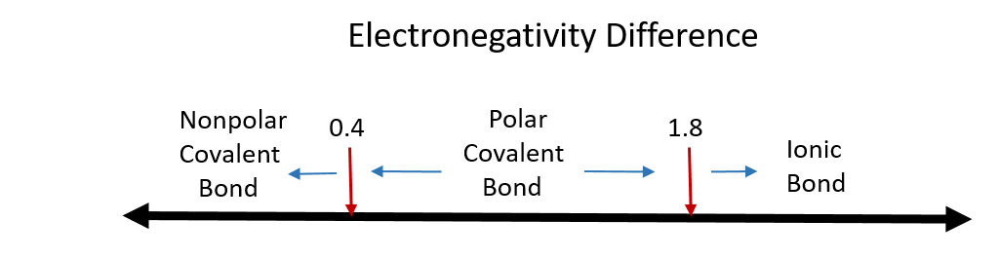
Determining Bond Type
What type of bond does NaCl form?
3.0 – 0.9 = 2.1
CO?
3.5 – 2.5 = 1.0
PS₂?
2.5 – 2.1 = 0.4
Notes:
Ionic
Polar covalent

