Slide 1
https://www.youtube.com/watch?v=hqR2Cjr96yg
World Championship of Sand Sculpting in HD

Slide 2
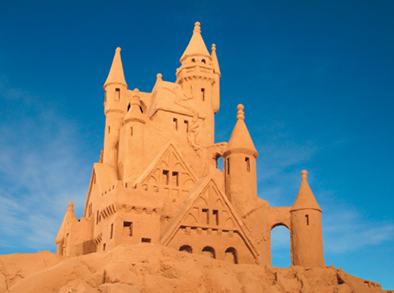
How can you quantify the amount of sand in a sand sculpture?
You could measure the amount of sand in a sculpture by counting the grains of sand.
Is there an easier way to measure the amount of sand?

Slide 3
Collect a blank sheet of paper and a 50 mL beaker with sand in it.
Discuss how you might count the grains of sand and write your final answer on your notes.
Gently pour the sand on your sheet of paper.
Count the grains of sand and record on your notes.
Have teacher sign off on your notes.
Slightly roll paper and pour sand back into the beaker and return materials.

Slide 4
In your study of chemistry, you will analyze the composition of samples of matter and perform chemical calculations that relate quantities of the reactants in a chemical reaction to quantities of the products.
To solve these and other problems, you will have to be able to measure the amount of matter you have.
How do you measure matter?

Slide 5
A Measurement of Matter
Learning Targets:
I will be able to:
describe methods of measuring the amount of a substance.
define Avogadro’s number as it relates to a mole of a substance.

Slide 6
Measuring Matter
Matter can be measured in three ways:
By counting
By determining the mass
By measuring the volume
Many different units are used in measuring matter.
Ex. meters, grams, joules, hertz, ⁰C,
units: a determinate quantity adopted as a standard of measurement

Slide 7
Measuring Matter
We often have to make conversions of measurements from one unit to another unit, this is accomplished through dimensional analysis.
dimension: a measurable characteristic of some kind, such as volume, mass, length, depth, or height
dimensional analysis: a way scientists convert units of measurement

Slide 8
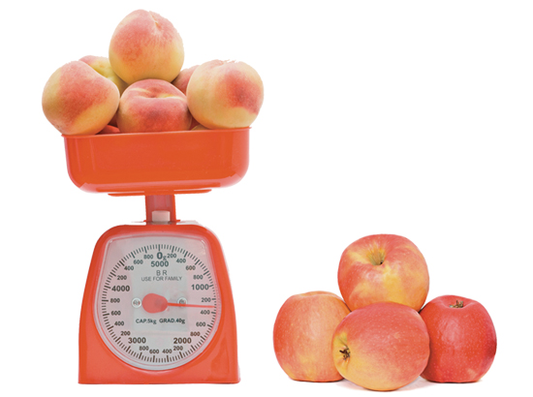
Measuring Matter
Apples can be measured in three different ways.
At a fruit stand, they are often sold by the count.
In a supermarket, you usually buy apples by weight or mass.
At an orchard, you can buy apples by volume.

Slide 9
Measuring Matter
Each of these different ways to measure apples can be equated to a dozen apples.
By count: 1 dozen apples = 12 apples
For average-sized apples, the following approximations can be used.
By mass: 1 dozen apples = 2.0 kg apples
By volume: 1 dozen apples = 0.20 bushel of apples

Slide 10
Measuring Matter
Knowing how the count, mass, and volume of an item relate to a common unit allows you to convert among these units.
For example, based on the unit-relationship, you could calculate the mass of a bushel of apples or the mass of 90 average-sized apples using conversion factors such as the following:
1 dozen apples
2.0 kg apples
1 dozen apples
12 apples
1 dozen apples
0.20 bushel apples

Slide 11
Measuring Matter
Finding Mass from a Count
What is the mass of 90 average-sized apples if 1 dozen of the apples has a mass of 2.0 kg?
Step 1 Analyze: List the knowns and the unknown.
Use dimensional analysis to convert the number of apples to the mass of apples.
KNOWNS UNKNOWN
number of apples = 90 apples mass of 90 apples = ? kg 12 apples = 1 dozen apples 1 dozen apples = 2.0 kg apples

Slide 12
Measuring Matter
Step 2 Calculate: Solve for the unknown.
First identify the sequence of conversions needed to perform the calculation.
number of apples
↓
dozens of apples
↓
mass of apples

Slide 13
Measuring Matter
Write the conversion factor to convert from number of apples to dozens of apples.
Write the conversion factor to convert from dozens of apples to mass of apples.
Multiply the number of apples by these two conversion factors to get the answer in kilograms.
1 dozen apples
2.0 kg apples
90 apples x
x
= 15 kg apples
12 apples
1 dozen apples
The units apples and dozen apples cancel, so the answer has the unit kg.

Slide 14
Measuring Matter
Step 3 Evaluate: Does the result make sense?
A dozen apples has a mass of 2.0 kg, and 90 apples is less than 10 dozen apples, so the mass should be less than 20 kg of apples (10 dozen x 2.0 kg/dozen).

Slide 15
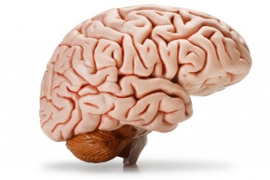
✓
What is “dimensional analysis”?
How do you measure matter?
Which conversion factor do you need for this problem?
1 meter or 1000 mm
1000 mm 1 meter
Convert 3.5 m to mm.
Notes:
A way scientists convert units of measurement
Counting, determining mass, measuring volume
1000 mm/1 m

Slide 16
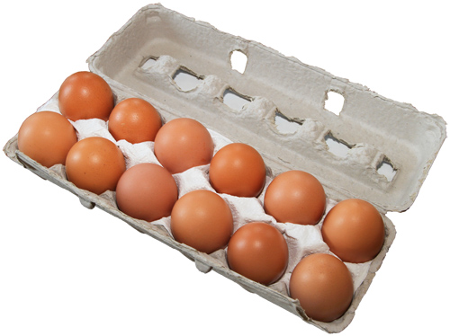
Measuring Matter
Recall that matter is composed of atoms, molecules, and ions.
These particles are much, much smaller than grains of sand, and an extremely large number of them are in a small sample of a substance.
Counting particles one by one is not practical.
Think about counting eggs.
It’s easier when the eggs are grouped into dozens.
A dozen is a specified number (12) of things.

Slide 17
Counting with Moles
Chemists also use a unit that is a specified number of particles.
The unit is called the mole.
mole (mol): the amount of a substance that contains 6.02 x 10²³ representative particles of that substance
Avogadro’s number: the number of representative particles contained in one mole of a substance; 6.02 x 10²³ particles

Slide 18
Counting with Moles
The term representative particle refers to the species present in a substance, usually atoms, molecules, or formula units.
representative particle: the smallest unit into which a substance can be broken down without a change in composition, usually atoms, molecules, or ions
Seven elements normally exist as diatomic molecules (H₂, N₂, O₂, F₂, Cl₂, Br₂, and I₂).
The mole allows chemists to count the number of representative particles in a substance.
A mole of any substance contains Avogadro’s number of representative particles, or 6.02 × 10²³ representative particles.

Slide 19
✓
How many atoms are in 2.0 moles of H₂?

