Slide 2
The Mole: A Measurement of Matter
https://www.youtube.com/watch?v=UL1jmJaUkaQ
Learning Targets:
I will be able to:
distinguish between the atomic mass and molar mass of an element.
describe how the mass of a mole of a compound is calculated.

Slide 3
Converting Between Number of Particles and Moles
The relationship 1 mol = 6.02 × 10²³ representative particles is the basis for the following conversion factors that you can use to convert numbers of representative particles to moles and moles to number of representative particles.
and
1 mol
6.02 × 10²³ representative particles
6.02 × 10²³ representative particles
1 mol

Slide 4
Converting Number of Atoms to Moles
How many moles of magnesium is 1.25 × 10²³ atoms of magnesium?
Step 1 Analyze: List the knowns and the unknown.
KNOWNS number of atoms = 1.25 × 10²³ atoms Mg
UNKNOWN moles = ? mol Mg
Step 2 Calculate: Solve for the unknown.
First state the relationship between moles and number of representative particles.
1 mol Mg = 6.02 × 10²³ atoms Mg

Slide 5
Converting Number of Atoms to Moles
Identify the conversion factor needed to convert from atoms to moles.
or
Multiply the number of atoms of Mg by the conversion factor.
1 mol Mg
6.02 × 10²³ atoms Mg
6.02 × 10²³ atoms Mg
1 mol Mg
1 mol Mg
1.25 × 10²³ atoms Mg x
= 0.208 mol Mg
6.02 × 10²³ atoms Mg

Slide 6
Converting Number of Atoms to Moles
Step 3 Evaluate: Does the result make sense?
The given number of atoms (1.25 × 10²³) is less than one-fourth of Avogadro’s number (6.02 × 10²³), so the answer should be less than one-fourth (0.25) mol of atoms.
Since the starting value had three significant figures, The answer should have three significant figures.

Slide 7
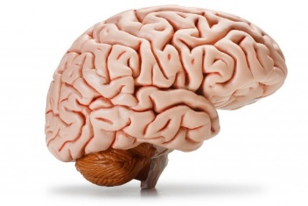
✓
On your “Notes Practice” paper, answer the following:
What does equal?
How many moles of Na⁺ does 1.505 x 10²³ atoms of Na⁺ convert to?
1 mol
6.02 × 10²³ representative particles
Notes:
= 1
1.505 x 10²³ / 6.02 x 10²³ = 0.25 mol

Slide 8
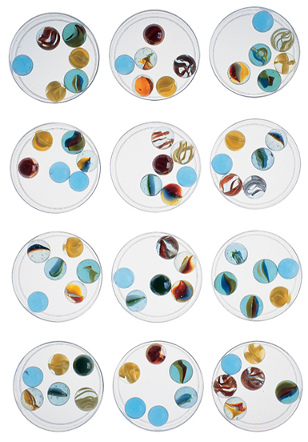
Converting Between Number of Particles and Moles
Suppose you want to determine how many atoms are in a mole of a compound.
To do this, you must know how many atoms are in a representative particle of the compound.
This number is determined from the chemical formula.
The number of marbles in a dozen cups is (6 × 12) or 72 marbles.
Similarly, a mole of molecules contains more individual particles than a mole of atoms.

Slide 9
Converting Between Number of Particles and Moles
The formula for carbon dioxide (CO₂), shows that one molecule of carbon dioxide is composed of three atoms: one carbon atom and two oxygen atoms.
A mole of carbon dioxide contains Avogadro’s number of CO₂ molecules.
Each molecule contains three atoms, so a mole of carbon dioxide contains 3x Avogadro’s number of atoms.

Slide 10
Converting Between Number of Particles and Moles
To find the number of atoms in a given number of moles of a compound, you must first determine the total number of representative particles
To convert moles of a compound to representative particles (molecules or formula units), multiply the number of moles by 6.02 × 10²³ representative particles/1 mol.
Then multiply the number of representative particles by the number of atoms in each molecule or formula unit.

Slide 11
✓
On your “Notes Practice” paper, answer the following:
If we have 1 mol of NaCl, how many molecules of NaCl do we have?
How many individual atoms do we have?
Notes:
6.02 x 10²³ molecules
1.204 x 10²⁴ atoms

Slide 12
Converting Moles to Number of Atoms
Propane is a gas used for cooking and heating. How many atoms are in 2.12 mol of propane (C₃H₈)?
Step 1 Analyze List the knowns and the unknown
The desired conversion is:
moles → molecules → atoms.
KNOWNS number of moles = 2.12 mol C₃H₈ 1 mol C₃H₈ = 6.02 × 10²³ molecules C₃H₈ 1 molecule C₃H₈ = 11 atoms
UNKNOWN number of atoms = ? atoms

Slide 13
Converting Moles to Number of Atoms
Step 2 Calculate Solve for the unknown.
First write the conversion factor to convert from moles to molecules.
Write the conversion factor to convert from molecules to atoms.
Remember to write the conversion factors so that the unit in the denominator cancels the unit in the numerator of the previous factor.
6.02 × 10²³ molecules C₃H₈
1 mol C₃H₈
11 atoms
There are 3 atoms of carbon and 8 atoms of hydrogen in 1 molecule of propane.
1 molecule C₃H₈

Slide 14
Converting Moles to Number of Atoms
Multiply the moles of C₃H₈ by the conversion factors.
Step 3 Evaluate Does the result make sense?
There are 11 atoms in each molecule of propane and more than 2 mol of propane, so the answer should be more than 20 times Avogadro’s number of propane molecules.
The answer should have two significant figures (11 has the least).
2.12 mol C₃H₈ ×
6.02 × 10²³ molecules C₃H₈
11 atoms
×
1 mol C₃H₈
1 molecule C₃H₈
= 140.3864 × 10²³ atoms
= 1.4 × 10²⁵ atoms

Slide 15
✓
On your “Notes Practice” paper, answer the following:
How is a mole similar to a dozen?
Describe the relationship between Avogadro’s number and one mole of any substance.
Which contains more molecules: 1.0 mol H₂O₂ or 1.0 mol C₂H₆?
Notes:
both refer to multiple objects or particles that are being thought of as a single object or particle
they are the same value with different units
they contain equal numbers of molecules

Slide 16
Molar Mass
How do we determine the molar mass of an element?

Slide 17
Molar Mass
When we mix chemicals for a reaction, we need to know how much of each chemical to use.
We need the correct amount of molecules, but different molecules have different masses.
We need to know the mass of 1.0 mole of the substance.
We get that mass from the Periodic table.

Slide 18
Molar Mass
atomic mass: the average of the masses of all the isotopes of an element
The atomic mass of an element expressed in grams is the mass of a mole of the element.
molar mass: the mass of one mole of an element or compound
The molar mass of an element is determined from it’s atomic mass on the Periodic Table.
The molar mass of a compound is the sum of molar masses of all the atoms in the compound.

Slide 19
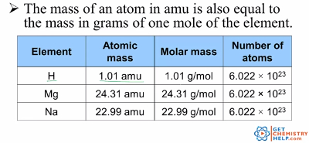
Molar Mass
Remember that the atomic mass of an element (the mass of a single atom) is expressed in atomic mass units (amu).

Slide 20
Molar Mass
We use the atomic mass obtained from the Periodic Table.
For carbon, the molar mass is 12.01 g.
For atomic hydrogen, the molar mass is 1.01 g.
The molar mass of a compound is determined by adding the molar masses of each atom in the molecular formula.
For water, H₂O, we add 2(1.01) + 15.999 to get a molar mass of 18.019 grams.

Slide 21
Molar Mass
To find the mass of a mole of a compound, you must know the formula of the compound.
To calculate the molar mass of a compound, find the number of grams in 1.0 mole of each element in the compound.
Add the masses of the elements for each atom in the compound (if there is more than one atom of an element, add for each atom).

Slide 22
✓
On your “Notes Practice” paper, answer the following:
What is the molar mass of gold?
What is the molar mass of NaCl?
What is the molar mass of H₂SO₄?
How many atoms are contained in a molar mass of an element?
Notes:
196.97 g
58.44 g
98.076 g
6.02 x 10²³

Slide 23
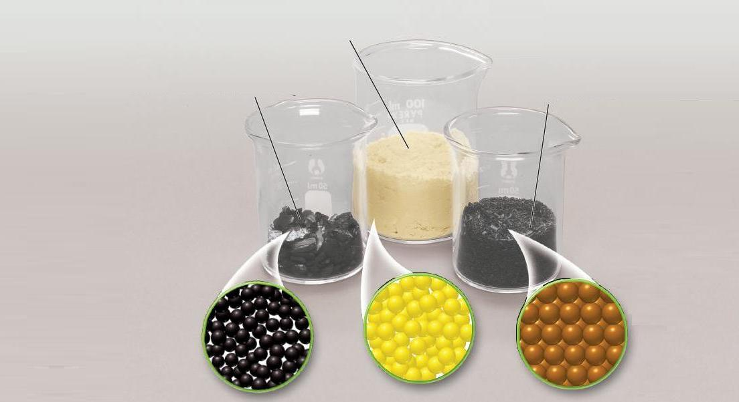
Molar Mass
1 mol of sulfur atoms = 32.1 g
1 mol of carbon atoms = 12.0 g
1 mol of iron atoms = 55.845 g
This figure shows one mole of carbon, sulfur, and iron.

Slide 24
The Mass of a Mole of a Compound
Molar mass is the mass of 1 mol of atoms of any element.
A molecule of SO₃ is composed of one atom of sulfur and three atoms of oxygen.
You can calculate the mass of a molecule of SO₃ by adding the atomic masses of the atoms making up the molecule.

Slide 25
The Mass of a Mole of a Compound
From the periodic table:
the atomic mass of sulfur (S) is 32.1 amu.
the atomic mass of oxygen (O) is 16.0 amu
There are three atoms of oxygen so the atomic mass of the oxygen atoms is 3 × 16.0 amu = 48.0 amu.
The molecular mass of SO₃ is: 32.1 amu + 48.0 amu = 80.1 amu.

Slide 26
✓
On your “Notes Practice” paper, answer the following:
How many moles are in 1.8 x 10²⁴ atoms of Fe?
How many molecules are in 2.4 moles of H₂O?
What is the molar mass of Na?
What is the molar mass of CaCl₂?
Notes:
3 moles
1.44 x 10²⁴ molecules
22.990 g/mol
110.98 g/mol

Slide 27
Conversion Summaries
Avogadro’s equivalency: 1 mole = 6.022 x 10²³ particles
Converting particles (atoms, molecules, or ions) to moles:
Starting unit x 1.0 mol
6.022 x 10²³ particles
Converting moles to particles:
Starting unit x 6.022 x 10²³ particles
1.0 mol
Determining molar mass:
sum of atomic masses of each atom in grams/mole

