Slide 1
Stoichiometry – Chemical Calculations
How do manufacturers know how to make enough of their desired products?
https://www.youtube.com/watch?v=ysGS-_6E80s
https://www.youtube.com/watch?v=fgLfhInA6-c

Slide 2
✓
What can happen if they use too much starting material (reactants)?
What can happen if they use to little starting material (reactants)?

Slide 3
Stoichiometry – Chemical Calculations
Learning Targets:
I will be able to:
explain how mole ratios are used in chemical calculations.
describe the general procedure for solving a stoichiometric problem.

Slide 4
Stoichiometry – Chemical Calculations
mole ratio: a conversion factor derived from the coefficients of a balanced chemical equation interpreted in terms of moles
In chemical calculations, mole ratios are used to convert between a given number of moles of a reactant or product to moles of a different reactant or product.

Slide 5
Stoichiometry – Chemical Calculations
Look at the balanced equation for production of ammonia:
N₂(g) + 3H₂(g) → 2NH₃(g)
Three different mole ratios can be derived from this balanced equation.
1 mol N₂
2 mol NH₃
3 mol H₂
3 mol H₂
1 mol N₂
2 mol NH₃

Slide 6
Mole to Mole Calculations
In the mole ratio below, W is the unknown, wanted quantity and G is the given quantity.
The values of a and b are the coefficients from the balanced equation.
The general solution for a mole-mole problem is given by:
b mol W xb
x mol G × = mol W
a mol G a

Slide 7
Calculating Moles of a Product
Problem: How many moles of NH₃ are produced when 0.60 mol of nitrogen reacts with hydrogen?
N₂(g) + 3H₂(g) → 2NH₃(g)
2 mol NH₃
0.60 mol N₂ x ----------------- = 1.2 mol NH₃
1 mol N₂
b mol W xb
x mol G × = mol W
a mol G a

Slide 8
Mass-Mass Calculations
In the laboratory the amount of a substance is usually determined by measuring its mass in grams.
If we know the mass of a reactant or product, then the mass of any other reactant or product can be calculated.
If a given sample (reactant or product) is measured in grams, it can be converted to moles by using the molar mass.
The mole ratio from the balanced equation can be used to calculate the number of moles of the unknown.
If it is the mass of the unknown that needs to be determined, the number of moles of the unknown can be multiplied by the molar mass.

Slide 9
Steps for Solving a Mass-Mass Problem
Change the mass of G to moles of G (mass G → mol G) by using the molar mass of G.
Change the moles of G to moles of W (mol G → mol W ) by using the mole ratio from the balanced equation.
Change the moles of W to grams of W (mol W → mass W ) by using the molar mass of W.
1 mol G
mass G × = mol G
molar mass G
b mol W
mol G × = mol W
a mol G
molar mass W
mol W × = mass W
1 mol W

Slide 10
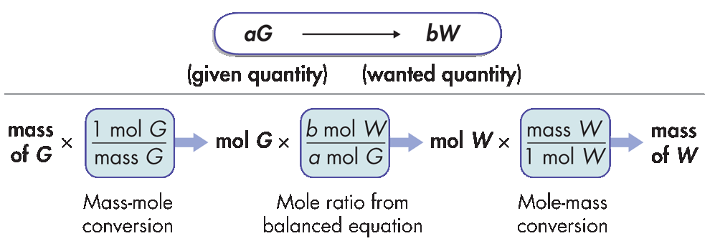
Steps for Solving a Mass-Mass Problem
Another way to represent the steps for doing mole-mass and mass-mole stoichiometric calculations is shown here:
For a mole-mass problem, the first conversion is skipped.
For a mass-mole problem, the last conversion is skipped.

Slide 11
Calculating the Mass of a Product
Calculate the number of grams of NH₃ produced by the reaction of 5.40 g of hydrogen with an excess of nitrogen. The balanced equation is:
N₂(g) + 3H₂(g) → 2NH₃(g)
1 mol H₂
2 mol NH₃
17.0 g NH₃
5.40 g H₂ ×
×
×
= 31 g NH₃
2.0 g H₂
3 mol H₂
1 mol NH₃
Given quantity
Change given unit to moles
Mole ratio
Change moles to grams

Slide 12
Other Stoichiometric Calculations
In a typical stoichiometric problem:
The given quantity is first converted to moles.
Then, the mole ratio from the balanced equation is used to calculate the number of moles of the wanted substance.
Finally, the moles are converted to any other unit of measurement related to the unit mole, as the problem requires.
The mole-mass relationship gives you two conversion factors.
1 mol
molar mass
and
molar mass
1 mol

Slide 13
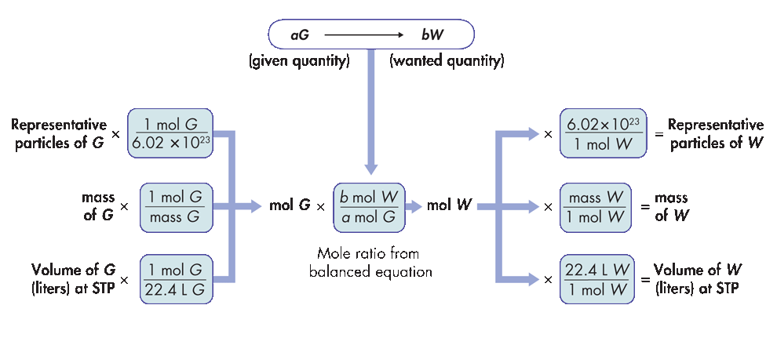
Other Stoichiometric Calculations
Summary of steps for typical stoichiometric problems:

Slide 14
✓
How many molecules of oxygen are produced when 29.2 g of H₂O is decomposed by electrolysis?
2H₂O  2H₂ + O₂
1.0 mol H₂O 1 mol O₂ 6.022 x 10²³ molecules O₂
29.2 g H₂O x ---------------- x ----------------- x -----------------------------------
18.0 g H₂O 2.0 mol H₂O 1 mol O₂
Given quantity Change to moles Mole Ratio Change to molecules
4.88 x 10²³ molecules O₂

Slide 15
Volume to Volume Calculations
Nitrogen monoxide and oxygen gas combine to form the brown gas nitrogen dioxide, which contributes to photochemical smog.
✓ How many liters of nitrogen dioxide are produced when 34 L of oxygen react with an excess of nitrogen monoxide? Assume conditions are at STP.
2NO(g) + O₂(g) → 2NO₂(g)
= 68 L NO₂
1 mol O₂
2 mol NO₂
22.4 L NO₂
34 L O₂ × × ×
22.4 L O₂
1 mol O₂
1 mol NO₂
Given quantity
Change to moles
Mole ratio
Change to liters

Slide 16
The Mole and Quantifying Matter
Mole ratios from the balanced equation are used to calculate the amount of a reactant or product in a chemical reaction from a given amount of one of the other reactants or products.

Slide 17
Stoichiometry – Chemical Calculations
Determining the amount of chemicals needed to create a specific volume of a gas for an air bag:
Measure the volume of gas needed to fill the air bag.
Convert the volume (assuming STP) to moles of gas.
Use the mole ratio from the balanced equation to calculate the needed moles of reactants.
Convert moles of reactants to mass (grams).

Slide 18
✓

