Slide 1
Welcome!
Peapenburg’s
Anatomy & Physiology
and
General Chemistry

Slide 2
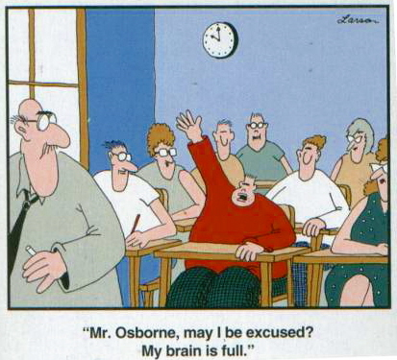
Daily Review
Begin filling out your student survey.

Slide 3
Emergency Response Procedure
1. Remain calm and follow the teacher’s instruction.
2. Take drills seriously and follow all procedures outlined in the emergency response flip chart located next to the door.
3. Stay quiet until the teacher indicates it is an appropriate time to talk.
4. If evacuation is required, quietly and orderly, exit room through emergency exit in the southeast corner.
5. Help peers get to where they need to go if they require assistance.

Slide 4
Lab Procedure
1. Do not touch any lab equipment until instructed to do so and safety equipment is on.
2. Be sure to follow all lab procedures and no unauthorized experimenting.
3. Absolutely no horseplay!
4. Area must be cleaned and lab materials put away before your group is dismissed.
5. Goggles/glasses can be removed as soon as the teacher has removed his.

Slide 5
Absence Procedure
1. Check in Homework Crate at the back of the room for missing work.
2. Ask a table mate to explain what we did during class.
3. If you are still unclear of the expectations after asking three classmates, then ask the teacher for clarification after school.
4. Indicate the date(s) you missed when turning in assignments at the top of the paper.
5. Turn in missing assignment within the allotted extra time.

Slide 6
Testing Procedure
1. Clear everything off of the table except for a writing utensil and calculator.
2. Use privacy screen to shield your test/quiz from other students.
3. No talking as soon as the first test/ quiz is passed out, until all tests are turned in.
4. No restroom breaks until all test/quizzes are turned in.
5. Raise your hand if you have a question.
6. When finished, turn test/quiz over and raise your hand. Teacher will come to you and collect your exam/quiz.
7. Quietly work on classwork from a different subject or read a book.

Slide 7
Daily Task Procedure
1. Be in assigned seat when the bell rings with all materials, ready to go.
2. Check the daily agenda for instructions and begin the bell work.
3. Maintain focus and remain quiet until teacher indicates you can collaborate with tablemates.
4. Raise your hand if you have a question and wait patiently to be called on.
5. Wait for the teacher to indicate it is time to pack up and be dismissed. You are dismissed at the end of class by the teacher, not the bell.

Slide 8
Leaving the Classroom
1. No restroom breaks in the middle of note taking/instruction or 10 minutes after/before bell rings.
2. Ask permission before leaving classroom.
3. If going any where other than the restroom, wait for teacher to write a pass before you leave.
4. Fill out sign out log on the clipboard with your full name AND
5. Use your phone to read the sign-out SQR code by door and fill out the google form.
6. Leave your phone by the sign-out log until you return.
7. Take the bathroom pass with you.
8. Upon your return, use your phone to read the sign-in SQR code and write in your return time on the clipboard log.

