Slide 1
Chemistry
Electron Configurations

Slide 2
Warm Up
Watch crash course clip:
  Crash Course Clip
Answer the following questions:
  1. Newlands compared the periodic table to what?
  2. Energy given off by electrons is called what?
  3. Electrons are better described as what?
  4. Electrons exist in what?
  5. How many different orbitals exist? What are they?
  6. What is an electron configuration?
  7. On your periodic table, label the orbitals.

Slide 3
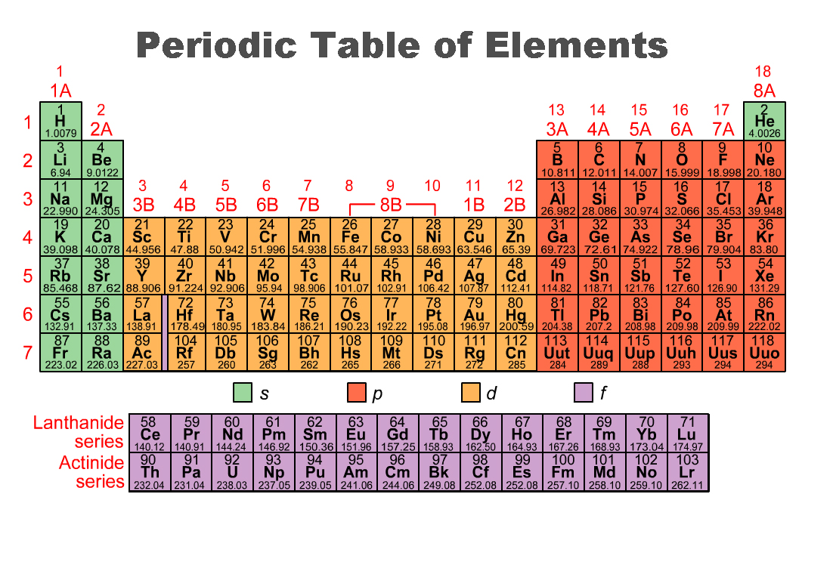
1s
1s
1
2
3
4
5
6
7
2p
2s
2p
3s
3p
4s
3d
4p
4p
5s
4d
5p
6s
5d
6p
7s
6d
7p
4f
6
7
5f

Slide 4

Connecting to the World
Does this scene look normal to you?
Surprisingly, it is!
Arrangements like this are normal but rare in nature because they are unstable.
Unstable arrangements, whether the grains of sand in a sandcastle or the rock formation shown here, tend to become more stable by losing energy.
If this rock were to tumble over, it would end up at a lower height. It would have less energy than before, but its position would be more stable.
In this section, you will learn that energy and stability play an important role in determining how electrons are configured in an atom.

Slide 5
Electron Configurations
Learning Targets:
I will be able to:
describe and use the three rules for writing the electron configurations of elements.
explain why actual electron configurations for some elements differ from those assigned using the aufbau principle.

Slide 6
Atomic Orbitals
Electrons are found in specific energy levels around the nucleus.
The rows of the Periodic Table are arranged to match these energy levels.
A certain amount of energy is needed to keep an electron in each level.
The level closest to the nucleus has the lowest energy.
The energy needed increases as the distance from the nucleus increases.

Slide 7
Atomic Orbitals
atomic orbital: a mathematical expression describing the probability of finding an electron at the various locations within the atom
Each orbital can hold two electrons.
The energy levels can have four different types of sublevels.
Sublevel types:
  s has 1 orbital d has 5 orbitals
  p has 3 orbitals f has 7 orbitals

Slide 8
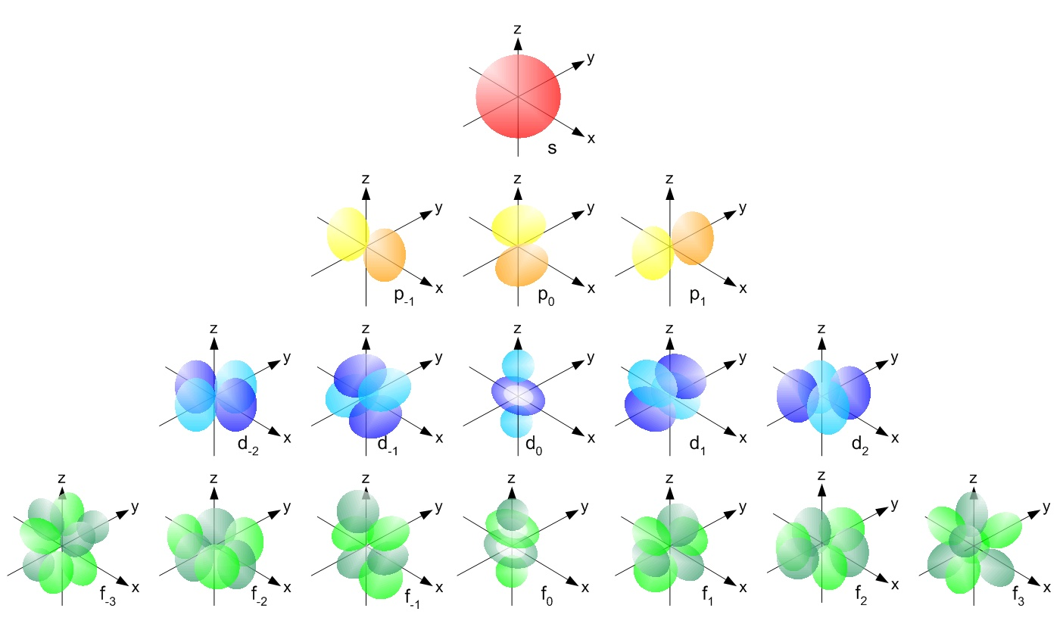
Atomic Orbitals!

Slide 9
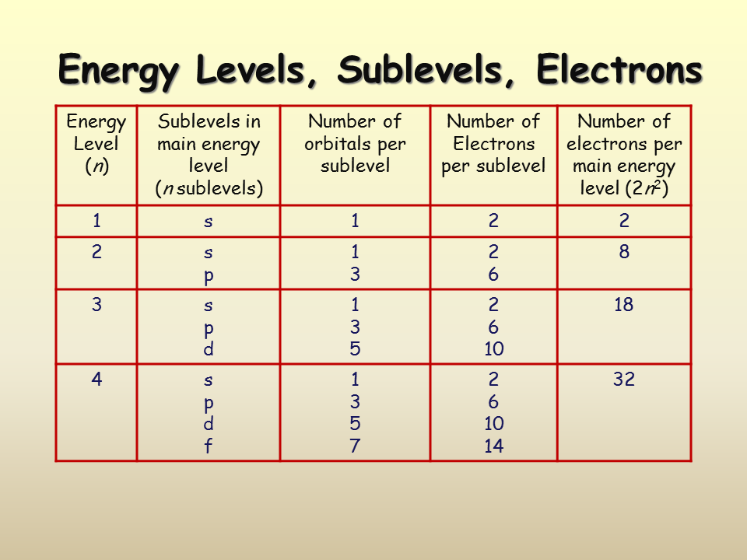
Atomic Orbitals

Slide 10

✓
2
Each orbital can hold _____ electrons.
There is/are _____ kind(s) of s orbital(s), therefore s can hold _____ electrons.
There is/are _____ kind(s) of p orbital(s), therefore p can hold _____ electrons.
There is/are _____ kind(s) of d orbital(s), therefore d can hold _____ electrons.
There is/are _____ kind(s) of f orbital(s), therefore f can hold _____ electrons.
Electrons are better described as what, as compared to matter?
1
2
3
6
5
10
7
14
Notes:
waves

Slide 11
✓
Electrons are better described as what, as compared to matter?
How many electrons can level 1 hold?
Level 2?
Level 3?
Notes:
Waves
2
8
18

Slide 12
Electron Configurations
electron configurations: the arrangement of electrons of an atom in its ground state in orbitals around the nucleus of the atom
Try to balance a pencil on its point.
Each time you try, the pencil falls over. At the end of its fall, its energy has decreased.
In most natural phenomena, change proceeds toward the lowest possible energy.

Slide 13
Electron Configurations
In an atom, electrons and the nucleus interact to make the most stable arrangement possible.
For larger atoms, electrons in the middle levels shield outer levels from the direct attraction between the outer electrons and the nucleus and alter the amount of energy needed to keep those outer electrons in their orbits.

Slide 14
Electron Configurations
As the atoms become larger on the Periodic Table, the number of electrons increases. (H = 1, He = 2, Li = 3, etc.)
There are specific rules as to how each electron is added to an orbital.
Electron configuration rules:
  The aufbau principle
  The Pauli exclusion principle
  Hund’s rule

Slide 15
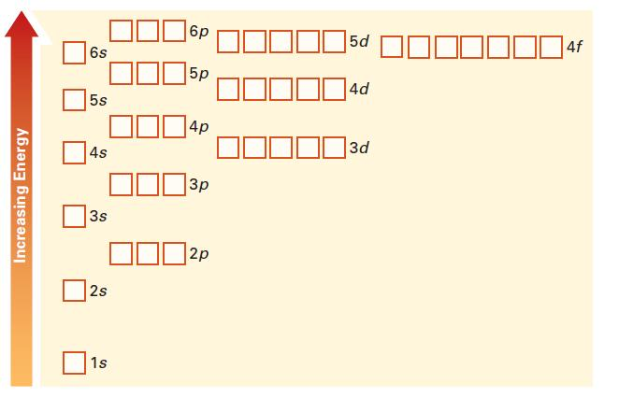
aufbau Principle
aufbau principle: the rule that electrons occupy the orbitals of lowest energy first
Each box represents an orbital. Each box can hold two electrons of opposite spins.
Electrons are added to an orbital until it is full.
aufbau Diagram

Slide 16
aufbau Principle
The orbitals for any sublevel of a principle energy level are always of equal energy. (E.G. all three orbitals of sublevel 2p have equal energy.)
In any principal energy level (1, 2, 3, 4) the s orbital is always the lowest-energy sublevel.
Energy levels within a principle energy level can overlap some of the energy levels of another principal level.
Filling of atomic orbitals does not follow a simple pattern after the second energy level. (E.G. the 4s orbital is lower in energy than a 3d orbital.)

Slide 17
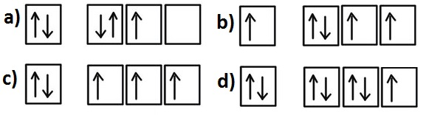
Pauli Exclusion Principle
Pauli exclusion principle: an atomic orbital may describe at most two electrons, each with opposite spin direction
Each orbital (such as s) can be occupied by one or two electrons.
To occupy the same orbital, two electrons must have opposite spins (paired clockwise and counterclockwise) .
Spin is an angular momentum of electrons and is usually thought of as clockwise or counterclockwise.
The spin of an electron is shown by up or down arrows (one arrow per electron).

Slide 18
Hund’s Rule
Hund’s rule: electrons occupy orbitals of the same energy in a way that makes the number of electrons with the same spin direction as large as possible
When you use the aufbau diagram to determine how electrons occupy orbitals of equal energy, one electron enters each orbital until all the orbitals contain one electron with the same spin direction.
Electrons of the opposite spin are not added until each orbital at that sublevel has one electron.
Second electrons then occupy each orbital so that their spins are paired with the first electron in the orbital. Thus each orbital can eventually have two electrons with paired spins.

Slide 19
✓
What is an electron configuration?
What does the aufbau principle tell us about electron configurations?
According to Hund’s rule, how are electrons added to orbitals?
Notes:
the arrangement of electrons of an atom in orbitals around the nucleus of the atom
electrons occupy the orbitals of lowest energy first
one electron enters each orbital until all the orbitals contain one electron with the same spin direction

Slide 20
Electron Configurations
To write out electron configurations we use shorthand method.
  Start with the primary energy level (1, 2, 3, 4, etc.)
  Add the sublevel (s, p, d, f)
  Lastly, add the number of electrons in that sublevel as a superscript number after the sublevel.

Slide 21
Electron Configurations
Hydrogen, with one electron in a 1s orbital, is written 1s¹.
Oxygen, with two electrons in a 1s orbital, two electrons in a 2s orbital, and four electrons in 2p orbitals, is written 1s²2s²2p⁴.
The sum of the superscripts equals the number of electrons in the atom.

Slide 22
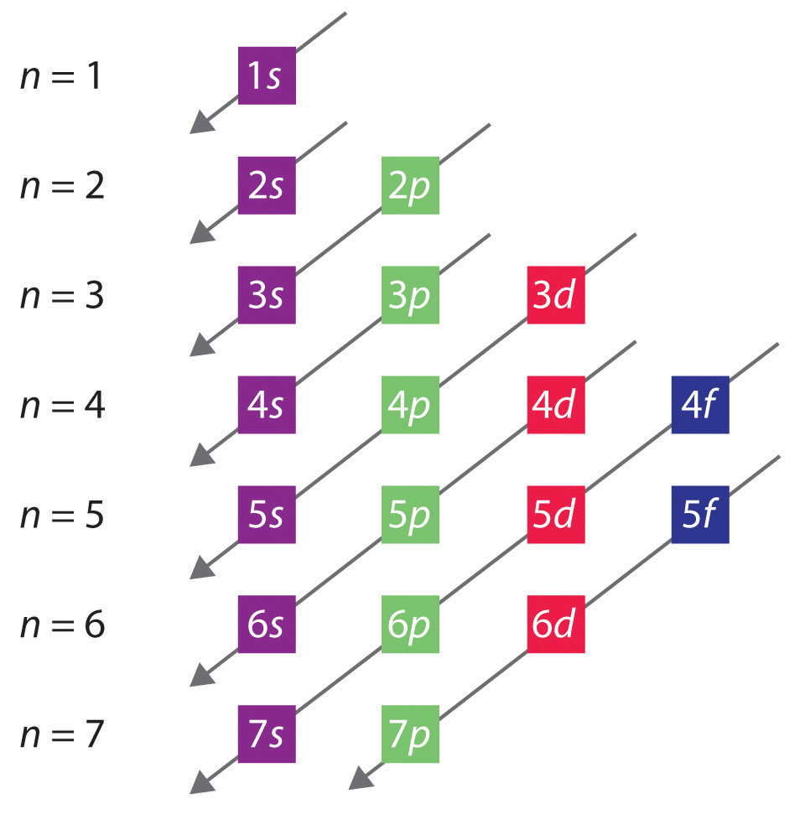
Electron Configurations
Purple =
1 orbital, 2 electrons
Green =
3 orbitals, 6 electrons
Red =
5 orbitals, 10 electrons
Blue =
7 orbitals, 14 electrons

Slide 23
Electron Configurations
When we fill the aufbau diagram, we want to look at how many electrons in an orbital level are unpaired. These unpaired electrons are what determines how atoms bond with each other.
In which of the following diagrams is the aufbau principle violated? Hund’s Rule?
How many unpaired electrons are there in c) and d)?
Notes:
a) violates Hund’s Rule and b) violates aufbau principle
c) = 3 unpaired, d) = 1 unpaired

Slide 24
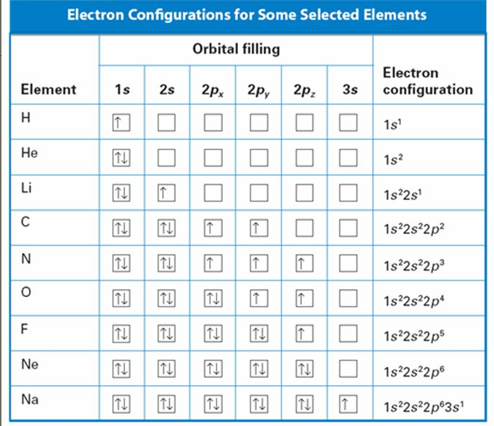
Hund’s Rule

Slide 25
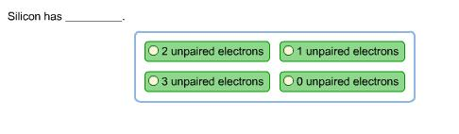
✓
Notes:
2 unpaired electrons

Slide 26
✓ Quiz!
On a separate sheet of paper, write electron configurations for atoms of the following elements. Include your name, date, and period.
How many unpaired electrons does each atom have?
Argon
1s²2s²2p⁶3s²3p⁶; no unpaired electrons
Sulfur
1s²2s²2p⁶3s²3p⁴; two unpaired electrons

Slide 27
Abbreviated Configurations
As we get to bigger atoms, the electron configuration gets longer.
For these larger atoms, we can write an abbreviated configuration to save space.
For Na (sodium) the electron configuration is 1s²2s²2p⁶3s¹
The abbreviated configuration for Na is [Ne]3s¹
                10
Zr = 1s² 2s² 2p⁶ 3s² 3p⁶ 4s² 3d¹⁰ 4p⁶ 5s² 4d²
Do you want a shorter way to write it?

Slide 28

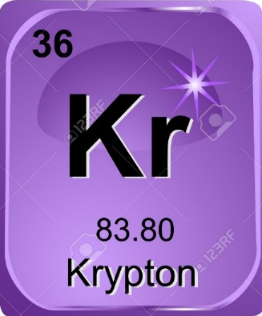
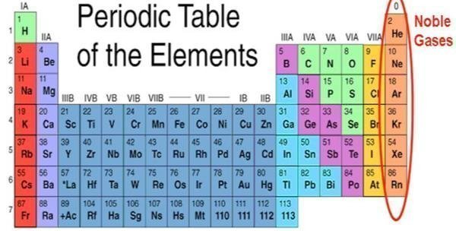
Abbreviated Configurations
Step 1: Find the element on the periodic table (atomic number 40).
Step 2: Go back to the last noble gas that was passed (atomic number 36).

Slide 29
Abbreviated Configurations
Step 3: Write the symbol of the noble gas in [brackets] to start your electron configuration. [ Kr ]
Put the atomic number of the noble gas beneath the symbol (36) to let you know the number of electrons already represented.
Determine the row the noble gas is in on the periodic table (4th row).
Step 4: Start the abbreviated configuration with sublevel s of the next row (5s).
Step 5: Continue the configuration until you run out of electrons.
[Kr]
36
5s
²4d²

Slide 30
✓ Quiz!
On your Quiz paper, write abbreviated configurations for atoms of the following elements.
Cd
Cl
Ba
Pb
Fe

Slide 31
✓
Cd = [Kr] 5s²4d¹⁰
36
Cl = [Ne] 3s²3p⁵
10
Ba = [Xe] 6s²
54
Pb = [Xe] 6s²4f¹⁴5d¹⁰6p²
54
Fe = [Ar] 4s²3d⁶
18

Slide 32
Exceptional Electron Configurations
In large atoms, the electron configuration does not always follow the rules.
Copper and chromium have electron configurations that are exceptions to the aufbau principle.
Aufbau configuration: Cr 1s²2s²2p⁶3s²3p⁶4s²3d⁴
Cu 1s²2s²2p⁶3s²3p⁶4s²3d⁹
Actual configuration: Cr 1s²2s²2p⁶3s²3p⁶4s¹3d⁵
Cu 1s²2s²2p⁶3s²3p⁶4s¹3d¹⁰

Slide 33
Exceptional Electron Configurations
Some actual electron configurations differ from the aufbau principle because half-filled sublevels are not as stable as filled sublevels and the energies between these sublevels are very close to each other.
Exceptions to the aufbau principle are due to subtle electron-electron interactions in orbitals with very similar energies.

Slide 34
Schrödinger and Heisenberg
Beyond Bohr’s model of the atom…
Schrödinger and Heisenberg created mathematical equations to describe the quantum state of electrons within an atom which produces a more accurate model of where the electrons hang out in the atom.
Thus the orbital shapes were identified!

Slide 35
Websites
Paired and Unpaired Electrons
https://www.sophia.org/tutorials/paired-and-unpaired-electrons
PERIODIC TABLE & PERIODIC LAW
http://mr.powner.org/c/lessons/periodic_table_and_law.html

Slide 36
Questions?

Slide 37
Polyelectronic Atoms
polyelectronic atoms: containing or consisting of more than one electron
When we construct polyelectronic atoms, we us the hydrogen-atom orbital nomenclature to describe the orbitals where the e⁻ reside (this is an approximation and surprising how well it works).
Orbital energies in polyelectronic atoms are different from those in H for 2 reasons:

Slide 38
Polyelectronic Atoms
Screening- the presence of other electrons means a given electron does not feel the attraction of the nucleus as strongly as it would in hydrogen.
Penetration- orbitals that have some probability density close to the nucleus will be energetically favored over orbitals that do not

Slide 40
Polyelectronic Atoms
Why not 3d before 4s?
  Most probable distance in 3d is closer to the nucleus than in 4s, but 4s allows for closer actual approach to nucleus due to penetration.
  This means 4s is energetically preferred over 3d!

Slide 41
Electron Configurations
Let’s make a ‘cheat sheet’ of these three rules that a your peer could use if they were absent today but had to take a quiz tomorrow….
  Number of the shell
  Letter of the orbital
  Number of the electrons in that orbital

Slide 42
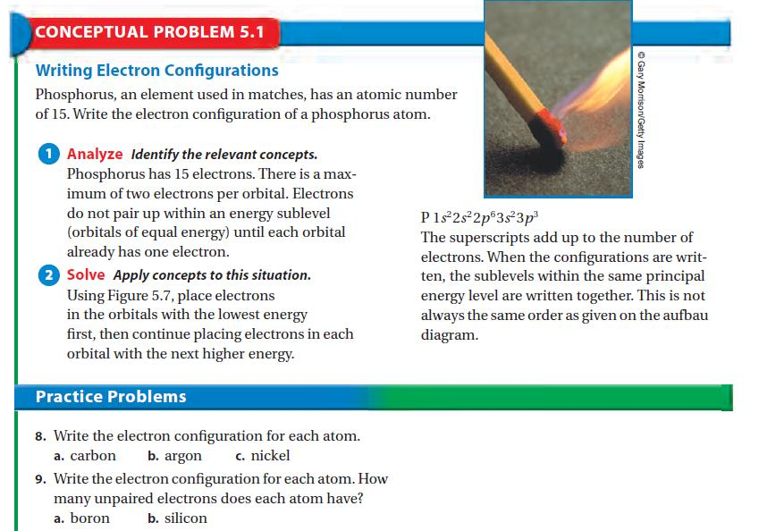

Slide 43
Checkpoint!
Exceptions to the aufbau principle are related to
electron-electron interactions in energy levels with principle quantum numbers of 1 or 2.
electron-electron interactions in orbitals with very similar energies.
interactions between electrons and protons in the nucleus.
the existence of orbitals with different shapes.

