Slide 1
Limiting Reagent and Percent Yield
Notes:
Play to 2:45

Slide 2
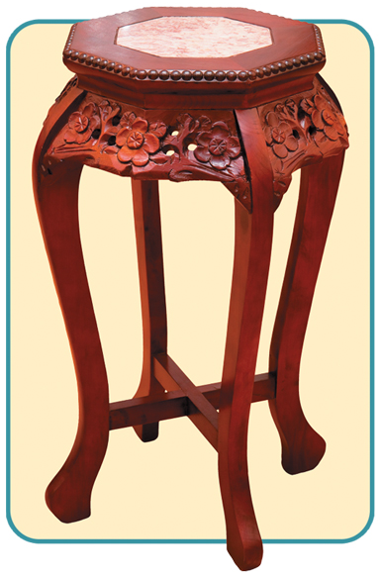
Limiting Reagent and Percent Yield
What determines how much product you can make?
If a carpenter had two tabletops and seven table legs, how many functional four-legged tables would he be able to build.? Why
https://www.youtube.com/watch?v=ymCZ2ShhBAw

Slide 3
Limiting Reagent and Percent Yield
Learning Targets:
I will be able to:
identify the limiting reagent in a reaction.
calculate theoretical yield, actual yield, or percent yield given appropriate information.

Slide 4
Limiting and Excess Reagents
To make tacos, you need enough meat, cheese, lettuce, tomatoes, sour cream, salsa, and seasonings.
If you have only 2 taco shells, the quantity of taco shells will limit the number of tacos you can make.
Thus, the taco shells are the limiting ingredient.

Slide 5
Limiting and Excess Reagents
In a chemical reaction, an insufficient quantity of any of the reactants will limit the amount of product that forms.
A balanced chemical equation is a chemist’s recipe.
Chemical Equations
 | N₂(g) | + | 3H₂(g) |  | 2NH₃(g)
“Microscopic recipe” | 1 molecule N₂ | + | 3 molecules H₂ |  | 2 molecules NH₃
“Macroscopic recipe” | 1 mol N₂ | + | 3 mol H₂ |  | 2 mol NH₃

Slide 6
Limiting and Excess Reagents
What would happen if two molecules (moles) of N₂ reacted with three molecules (moles) of H₂?
Experimental Conditions
 | Reactants | Products
Before reaction | 2 molecules N₂ 3 molecules H₂ | 0 molecules NH₃

Slide 7
Limiting and Excess Reagents
Before the reaction takes place, N₂ and H₂ are present in a 2:3 molecule (or mole) ratio.
As the reaction takes place, 1 molecule (or mole) of N₂ reacts with 3 molecules (or moles) of H₂ to produce 2 molecules (or moles) of NH₃.
Experimental Conditions
 | Reactants | Products
Before reaction | 2 molecules N₂ 3 molecules H₂ | 0 molecules NH₃
After reaction | 1 molecule N₂ 0 molecules H₂ | 2 molecules NH₃

Slide 8
Limiting and Excess Reagents
All the H₂ has now been used up, and the reaction stops.
One molecule (or mole) of unreacted N₂ is left in addition to the two molecules (or moles) of NH₃ that have been produced by the reaction.
Experimental Conditions
 | Reactants | Products
Before reaction | 2 molecules N₂ 3 molecules H₂ | 0 molecules NH₃
After reaction | 1 molecule N₂ 0 molecules H₂ | 2 molecules NH₃

Slide 9
Limiting and Excess Reagents
In this reaction, only the hydrogen is completely used up.
H₂ is the limiting reagent, or the reactant that determines the amount of product that can be formed by this reaction.
A limited quantity of any of the reactants that are needed to make a product will limit the amount of product that forms.
limiting reagent: any reactant that is used up first in a chemical reaction
excess reagent: any reactant that remains after the limiting reagent is used up in a chemical reaction

Slide 10
✓
How is the amount of product in a reaction affected by an insufficient quantity of any of the reactants?

Slide 11
Determining the Limiting Reagent
Example Problem:
Copper reacts with sulfur to form copper(I) sulfide according to the following balanced equation:
2Cu(s) + S(s) → Cu₂S(s)
What is the limiting reagent when 80.0 g Cu reacts with 25.0 g S?

Slide 12
Determining the Limiting Reagent
STEP 1: List the knowns and the unknown.
Knowns Unknown
mass of copper = 80.0 g Cu limiting reagent = ?
mass of sulfur = 25.0 g S
molar mass of Cu = 63.5 g/mol
molar mass of S = 32.1 g/mol
1 mol S
2 mol Cu

Slide 13
Determining the Limiting Reagent
STEP 2: Solve for the unknown.
Start with the reactants and convert from mass to moles.
1 mol Cu
80.0 g Cu × = 1.26 mol Cu
63.5 g Cu
1 mol S
25.0 g S × = 0.779 mol S
32.1 g S

Slide 14
Determining the Limiting Reagent
Now, convert moles of Cu to moles of S needed to react with 1.26 moles of Cu.
Compare the amount of sulfur needed with the given amount of sulfur.
0.630 mol S < 0.779 mol S
(amount needed to react) (given amount)
Sulfur is in excess, so copper is the limiting reagent.
1 mol S
1.26 mol Cu × = 0.630 mol S
2 mol Cu
Given quantity
Mole ratio
Amount of S needed to react w/ the given Cu

Slide 15
✓
How would you set up the problem to convert the calculated moles of S to moles of Cu needed to react with 0.779 mol S?
0.779 mol S x =
Given = 1.26 mol Cu
Needed Amount = 1.558 mol Cu
Insufficient Cu to react with all the S, Cu is the limiting reagent.
2 mol Cu
1.558 mol Cu
1 mol S

Slide 16
Finding the Quantity of Product from the Limiting Reagent
Example Problem:
What is the maximum number of grams of Cu₂S that can be formed when 80.0 g Cu reacts with 25.0 g S?
(same quantities from previous problem)
2Cu(s) + S(s) → Cu₂S(s)
The limiting reagent, which was determined in the previous sample problem, is used to calculate the maximum amount of Cu₂S formed.

Slide 17
Finding the Quantity of Product from the Limiting Reagent
STEP 1: List the knowns and the unknown.
Knowns Unknown
limiting reagent = 1.26 mol Cu Yield = ? g Cu₂S
(from sample problem 12.8)
1 mol Cu₂S = 159.1 g Cu₂S
(molar mass)
1 mol Cu₂S (mole ratio from balanced equation)
2 mol Cu

Slide 18
Finding the Quantity of Product from the Limiting Reagent
STEP 2: Solve for the unknown.
Start with the moles of the limiting reagent and convert to moles of the product. Use the mole ratio from the balanced equation.
Finish the calculation by converting from moles to mass of product.
1 mol Cu₂S
159.1 g Cu₂S
1.26 mol Cu ×
2 mol Cu
×
= 100 g Cu₂S
1 mol Cu₂S

Slide 19
Percent Yield
https://www.youtube.com/watch?v=dodsvTfqWNc
percent yield: the ratio of the actual yield to the theoretical yield for a chemical reaction expressed as a percentage
theoretical yield: the amount of product that could form during a reaction calculated from a balanced chemical equation
actual yield: the amount of product that forms when a reaction is carried out in the laboratory

Slide 20
Percent Yield
What does the percent yield of a reaction measure?
When a balanced chemical equation is used to calculate the amount of product that will form during a reaction, the calculated value represents the theoretical yield.
Because the actual yield of a chemical reaction is often less than the theoretical yield, the percent yield is often less than 100%.
actual yield
percent yield =
× 100%
theoretical yield

Slide 21
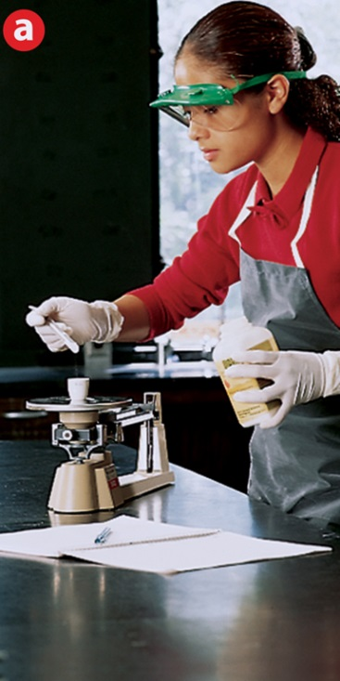
Percent Yield
The percent yield is a measure of the efficiency of a reaction carried out in the laboratory.
The mass of one of the products, the actual yield, is measured. The percent yield is calculated.
The mass of the reactant is measured.
The reactant is heated.

Slide 22
Percent Yield
Many factors cause percent yields to be less than 100%.
Reactions do not always go to completion; when a reaction is incomplete, less than the calculated amount of product is formed.
Impure reactants and competing side reactions may cause unwanted products to form.
Actual yield can be lower than the theoretical yield due to a loss of product during filtration or in transferring between containers.
If reactants or products have not been carefully measured, a percent yield of 100% is unlikely.

Slide 23
✓
What is the difference between theoretical yield and actual yield?
What will happen to the percent yield if reactants and products are not measured carefully?
How do we calculate percent yield?
Notes:
theoretical is the amount that can form, actual is the amount that actually does form
percent yield will not be 100%
actual yield / theoretical yield x 100

Slide 24
Calculating Theoretical Yield
Example Problem:
Calcium carbonate, which is found in seashells, is decomposed by heating. The balanced equation for this reaction is
What is the theoretical yield of CaO if 24.8 g CaCO₃ is heated?
Δ
CaCO₃(s) → CaO(s) + CO₂(g)

Slide 25
Calculating Theoretical Yield
STEP 1: List the knowns and the unknown.
Knowns
mass of CaCO₃ = 24.8 g CaCO₃
1 mol CaCO₃ = 100.1 g CaCO₃ (molar mass)
1 mol CaO = 56.1 g CaO (molar mass)
1 mol CaO/1 mol CaCO₃ (mole ratio from balanced equation)
Unknown theoretical yield = ? g CaO

Slide 26
Calculating Theoretical Yield
STEP 2: Solve for the unknown.
Start with the mass of the reactant and convert to moles of the reactant.
Next, convert to moles of the product using the mole ratio.
Finish by converting from moles to mass of the product.
= 13.9 g CaO
1 mol CaCO₃
1 mol CaO
56.1 g CaO
24.8 g CaCO₃ × × ×
100.1 g CaCO₃
1 mol CaCO₃
1 mol CaO

Slide 27
Calculating Percent Yield
Example Problem:
What is the percent yield if 13.1 g CaO is actually produced when 24.8 g CaCO₃ is heated?
Δ
Calculate the theoretical yield first. Then you can calculate the percent yield.
CaCO₃(s) → CaO(s) + CO₂(g)

Slide 28
Calculating Percent Yield
STEP 1: List the knowns and the unknown.
Knowns
actual yield = 13.1 g CaO
theoretical yield = 13.9 g CaO (from sample problem 12.10)
Unknown =percent yield =
actual yield
× 100%
theoretical yield

Slide 29
Calculating Percent Yield
STEP 2: Solve for the unknown.
Substitute the values for actual yield and theoretical yield into the equation for percent yield.
13.1 g CaO
94.2%
percent yield = × 100% =
13.9 g CaO

Slide 30
✓
Carbon tetrachloride, CCl₄, is a solvent that was once used in large amounts in dry cleaning. One reaction that produces carbon tetrachloride is
What is the percent yield of CCl₄ if 617 kg is produced from the reaction of 312 kg of CS₂?
CS₂ + 3Cl₂ → CCl₄ + S₂Cl₂

Slide 31
Calculating Percent Yield
STEP 1: List the knowns and the unknown.
Knowns
312 kg CS₂ = 312,000 g CS₂
actual yield = 617 kg CCl₄ = 617,000 g CCl₄
Unknown
theoretical yield = ?
percent yield = ?

Slide 32
✓
STEP 2: Calculate
= 630,000 g CCl₄ = 630 kg CCl₄
1 mol CS₂
1 mol CCl₄
153.81 g CCl₄
312,000 g CS₂ × × ×
76.142 g CS₂
1 mol CS₂
1 mol CCl₄
617 kg CCl₄
Percent yield = × 100 =
97.9%
630 kg CCl₄

Slide 33
✓
What is the molar mass of C₄H₆O₃?
What is the molar mass of H₂SO₄?
If starting with 2.5 moles of butane (C₄H₁₀) and 12.5 moles of oxygen (O₂), what is the limiting reagent?
2C₄H₁₀ + 13O₂  8CO₂ + 10H₂O
Notes:
4(12) + 6(1) + 3(16) = 102 g/mol C₄H₆O₃
2(1) + 32 + 4(16) = 98 g/mol H₂SO₄
3) 2.5 mol C₄H₁₀ x 13 mol O₂ / 2 mol C₄H₁₀ = 16.25 mol O₂ 12.5 mol < 16.25 mol LR = O₂

Slide 34
Summary of Limiting Reagent & Percent Yield
Determining Limiting Reagent
1) Pick quantity of one reactant (use quantity with a simpler number).
2) Use mole ratio to determine the needed quantity of other reactant.
3) Compare needed quantity with actual quantity of 2nd reactant.
Finding the Quantity of Product from the Limiting Reagent
1) Use given quantity of limiting reagent.
2) Convert grams to moles of limiting reagent.
3) Convert moles of limiting reagent to moles of product (using mole ratio).
4) Convert moles of product to grams of product.

Slide 35
Summary of Limiting Reagent & Percent Yield
Calculating Theoretical Yield
1) Convert quantity given in the problem to moles of given.
2) Convert the moles of given to moles of product.
3) Convert moles of product to grams of product.
Calculating Percent Yield
1) Determine the theoretical yield.
2) Divide the actual yield by the theoretical yield.
3) Multiply the quotient by 100.

