Slide 1
Chemistry
Scientific Method

Slide 2
Bell Work
What are the steps to the scientific method?

Slide 3
History in Science
By the 1500s in Europe, there was a shift from alchemy to science. Science flourished in Britain in the 1600s, partly because King Charles II was a supporter of the sciences. With his permission, some scientists formed the Royal Society of London for the Promotion of Natural Knowledge. The scientists met to discuss scientific topics and conduct experiments.
The society’s aim was to encourage scientists to base their conclusions about the natural world on experimental evidence, not on philosophical debates.

Slide 4
History in Science
In France, Antoine-Laurent Lavoisier did work in the late 1700s that would revolutionize the science of chemistry.
Lavoisier helped to transform chemistry from a science of observation to the science of measurement that it is today.

Slide 5
History in Science
To make careful measurements, Lavoisier designed a balance that could measure mass to the nearest 0.0005 gram.
At the time of the French Revolution, Lavoisier was a member of the despised royal taxation commission. He took the position to finance his scientific work. Although he was dedicated to improving the lives of the common people, his association with taxation made him a target of the revolution. In 1794 he was arrested, tried, and beheaded.

Slide 6
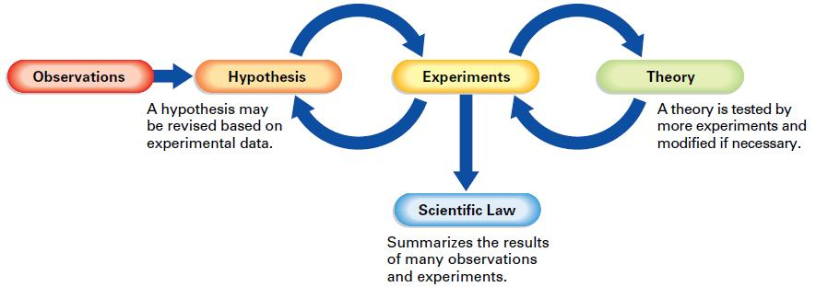
Scientific Method
Scientific Method
A series of problem–solving procedures that help scientists conduct experiments.

Slide 7
Scientific Method
Getting to the first waypoint (Observations):
Step 1: Use your senses to obtain information.
Step 2: Does this lead to a question?

Slide 8
Scientific Method
Getting to the second waypoint (Hypothesis):
Step 1: Define a problem/subject to study from your observations.
Step 2: Acquire background information.
Step 3: Form a hypothesis.
A hypothesis is a testable explanation of a situation that can be supported or disproved by careful procedures.
When the experimental data does not fit a hypothesis, the hypothesis must be changed.

Slide 9
Scientific Method
Getting to the third waypoint (Experiments):
Step 1: Design a procedure that is used to test your hypothesis.
Your design should include variables (factors that can change)
Dependent variable (responding)
Independent variable (manipulated)
Constant variables (kept the same)
For the hypothesis to be accepted, the experiment must produce the same results no matter who or how many times it is repeated.
S:\Earth Science Lab\Week 01-04\Chapter 1 - Intro\Video - Scientific Method Variables.wmv

Slide 10
Scientific Method
Getting to the fourth waypoint (Theory):
Step 1: This is a hypothesis that meets the test of repeated experimentation.
Textbook definition: a well-tested explanation for a broad set of observations.
Step 2: Theories for science are not proven!
We need to leave open the possibility that a theory may need to be changed at some point in the future to explain new observations or experimental results.

Slide 11
Scientific Method
Getting to the last waypoint (Scientific Law):
Textbook definition: a concise statement that summarizes the results of many observations and experiments.
Basically a super-theory summary!
Does not try to explain the relationship simply states the relationship.
i.e. gas laws

Slide 12
Scientific Method
Key idea to the scientific method!
The scientific method(s) are not rigid, step-by-step outlines to solve problems.
The important concept is that systematic investigation is integral in any intellectual pursuit.
You have to be able to tell me why you believe what you believe and why it is really real…

Slide 13
Create!
Your group is going to create a scenario where you can apply the scientific method. Be sure to include:
Problem/question
Form hypothesis
How will you test this?
Variables?

Slide 14
Sharing is caring…
Let’s share what our groups came up with.
Which group do you think had a problem/question that was the most aligned to the scientific method.
Explain why you chose this group and give 3 pieces of evidence.

Slide 15
The Depth Of Knowledge Levels
Level 1: Recall
This level involves basic tasks that require recall of facts or rote reproduction of simple procedures. These kinds of tasks do not require any cognitive effort beyond remembering the right response or formula.
Level 2: Skills and Concepts
This level requires a student to make some decisions about problem solving and procedures. DOK 2 tasks may involve applying a skill in a new context or explaining thinking in terms of concepts.
Level 3: Strategic Thinking
This level gets more complex and abstract. Students must use reasoning, planning, and evidence to explain their thought processes. Often, Level 3 tasks have more than one valid response, and students must justify their choices.
Level 4: Extended Thinking
Level 4 tasks are at least as complex as level 3 tasks but require an extended time period—several weeks, perhaps, or even longer—to complete.

Slide 16
Quiz Time!
In your groups, make 5 quiz questions pertaining to the scientific method.
3 questions must be DOK 1-2 &
2 questions must be DOK 3-4.
Be sure to make an answer key on a separate sheet of paper.
Next, we will switch quizzes with another group and take their quiz.

Slide 17
Closure
Explore how the scientific method relates to another topic/idea you are currently studying in another course. Write a paragraph that describes the connection in detail. Then in another paragraph explain why the scientific method is important.

Slide 18
Lab Reports
How do we apply the scientific method to lab reports?

Slide 19
Pre-Lab
Abstract
Introduction
Hypothesis
Procedures
Material list

Slide 20
Abstract
The abstract explains why the experiment was performed and what conclusions were drawn from the results obtained.
A general guideline for an abstract has five areas of focus:
why the experiment was conducted;
the problem being addressed;
what methods were used to solve the problem;
the major results obtained;
and the overall conclusions from the experiment as a whole.

Slide 21
Abstract
Do not be misled, however, from this list into thinking that the abstract is a long section. In fact, it should be significantly shorter than all of the others. All of this information should be summarized in a clear but succinct manner if the abstract is going to be successful.
Your abstract should only be 1-2 paragraphs long.

Slide 22
Introduction
The introduction section of a lab report is where you tell the reader your reason for doing the lab in the first place.
Be sure to include pertinent background information so that the reader can fully understand the findings from your experiment.
This information will come from what we have learned in class as well as additional research.
This section will also include your overarching question/problem, hypothesis, and predictions.

Slide 23
Introduction
The hypothesis is a testable explanation of the question/problem where you discuss the how/why of the problem at hand.
Hypothesis: can be done in two ways:
If _____________, then _______________.
The statement after “if” tells what is done with the independent variable.
The statement after “then” tells how the dependent variable is affected by the independent variable. or
1-2 sentences explaining how the independent variable affects the dependent variable.
Your hypothesis must explain the question/problem and be testable. It should not be a prediction of results.

Slide 24
Procedure
The procedure section of a lab report will include the ‘how’ and ‘what’ of your experiment.
This is a very clear, step-by-step list of procedures you plan on doing during the experiment.
Each step should be short and concise. You must also include your material list.

Slide 25
Procedure
Materials:
Your materials list must be VERY complete.
You need to indicate how much of each material will be used in the experiment so you know what you’ll need.
If you plan on arranging some of the equipment into a more complex setup (for example, if you’re going to heat something over a Bunsen burner, you’d need a ring stand, wire gauze, etc.), draw it as well as mentioning the equipment used.

Slide 26
Experiment/ Results
As you are conducting your procedures, collect data, make observations, design a chart, etc. in which to organize your data.
Be sure to record your data in your lab composition book.
Create graphs if needed to present data.

Slide 27
Post-Lab
Analysis:
(Statistically) analyze data from results section
Graphs or charts of data.
Conclusion:
Discussion (What does it mean?)
Communication

Slide 28
Analysis
Create charts or graphs of your data.
Conduct statistical analysis of your data (mean, median, mode, variance, standard deviation)
You must explain where your data came from or show your work for any math that you needed to compute to complete your data charts, etc.

Slide 29
Conclusion
In this section you will discuss what your data means.
This needs to be thorough!
The conclusion is also where you state whether or not your hypothesis was supported.
Use evidence (from your results section) to support your conclusion!

Slide 30
Discussion
What now? This is where we explain where we are headed next after we have completed our experiment.
You must include a brief error analysis section.
You should list at least two things that could have caused errors in the lab as well as ways you can prevent those errors in the future.

Slide 31
Discussion
The errors you mention should be errors that you can do something about, not mystical errors that probably didn’t happen.
You should also tie in any relationships to current class content and objectives.

Slide 32
Oreo Cookies!
We will be comparing traditional Oreo cookies to the double stuffed Oreo cookies.
In your groups, come up with the question/problem your group will be investigating.
Next, brainstorm what you should include in your introduction.

Slide 33
Post-Lab Honors
Conclusion
Analyze data from results section
Discussion
What now?
The Scientific Methods: Crash Course History of Science #14
https://www.youtube.com/watch?v=UdQreBq6MOY

